Slide 1


SOCIAL FORCE.
A new approach for improving the data quality
Project for the course “Embedded systems”
Skoltech, 2025

Slide 2
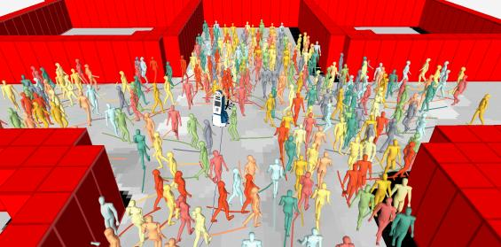
A brief intro
Social force concept
Pedestrian movement can be likened to the behavior of gases and fluids, where individual particles (pedestrians) interact with one another and their environment, such as malls, train stations, and public areas.
Key related terms:
Behavioral Reactions
Automatic Responses
Equation of Motion

Slide 3

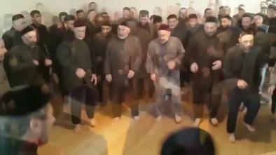
A brief intro. Motivation
social force model
= a novel study with practical potential, but it currently lacks an experimental setup

Slide 4
Problem statement
Problem
The field of study on Social Force is novel with a lack of existing frameworks simulating social forces.
Proposed Solution #1
Proposed Solution #2
Propose a methodology for conducting experiments related to Social force concept.
Share our insights about how to conduct such experiments, the downsides which can be met at the experimental stage.

Slide 5
Connecting Social Force with Embedded systems
On-board
real-time
processing
Simulations & Monitoring
Data
Collection
The system computes social forces (repulsion, attraction, goal direction) and predicts trajectories in real-time.
Retrieve behavioral patterns from videos.
Sensor data (e.g., position, velocity) is filtered, interpreted, and converted into force vectors.
Hardware device (in our case, RGBD cameras) gather pedestrian movement in various settings.
Notes:
IoT provides real-time data on human movement and behavior, which enhances social force models for crowd prediction and management. By integrating sensors, cameras, and wearables, IoT enables dynamic adjustments in public spaces, improving safety and efficiency in smart cities, events, and emergencies.

Slide 6



Methodology
Theoretical Study
Conducted a preliminary exploration of existing approaches and theoretical foundations of the Social Force model in the case of impact factor.
Experimental Setup with cameras
Collected a dataset by recording videos for analysis.
Software implementation
Utilized an open-source tool alongside a custom-developed approach to evaluate our data.

Slide 7
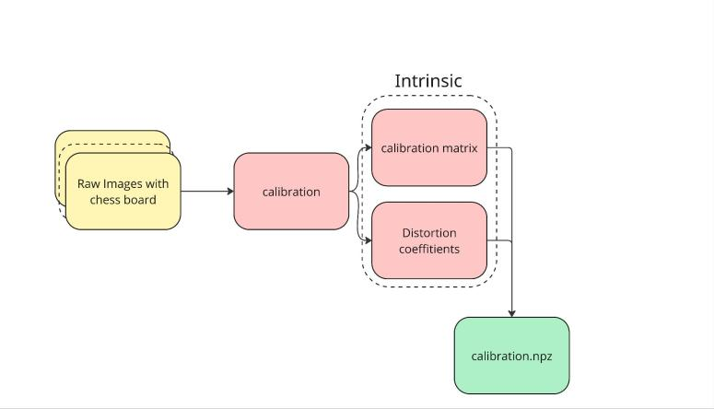
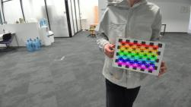
OLD approach for calibration

Slide 8
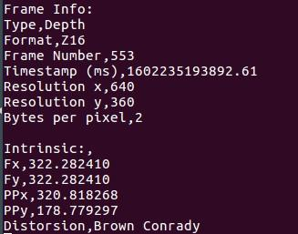
NEW approach for calibration…
Calibration Not Required
Intrinsic parameters are provided by the manufacturer
No additional calibration needed for most RGBD cameras
… simplifies a setup and data acquisition process

Slide 9
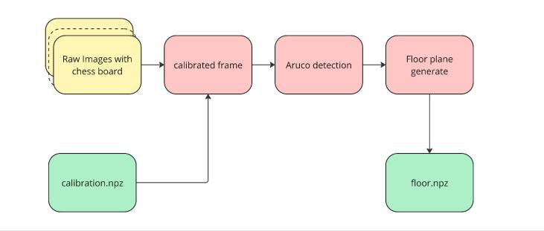
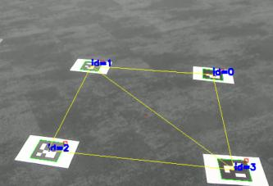
Framework for floor plane calculating

Slide 10
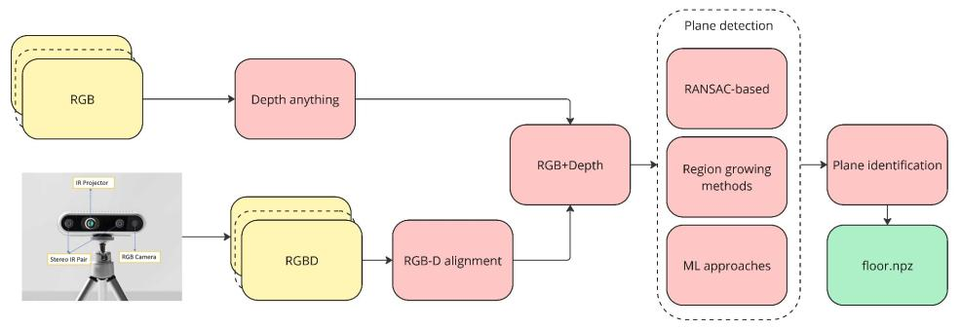
NEW Framework for obtaining trajectories

Slide 11
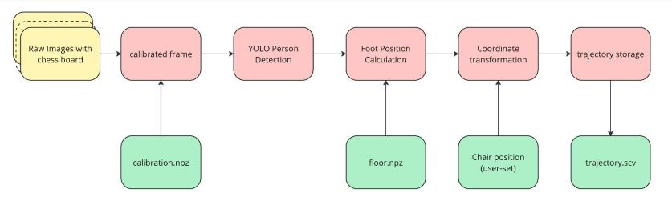
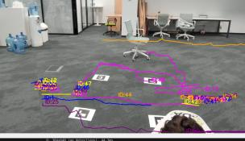
OLD Framework for obtaining trajectories

Slide 12
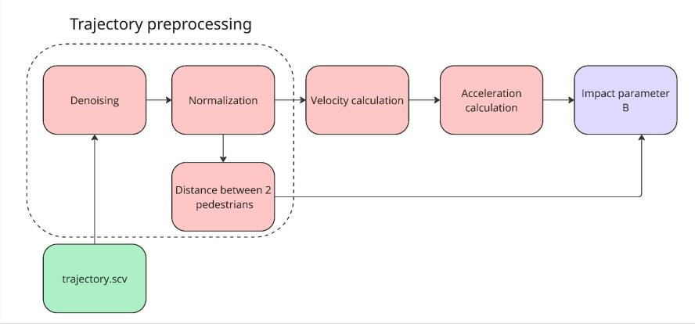
Framework of Social Force Estimatimation

Slide 13
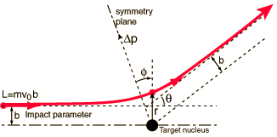
Feedback and Rethinking Our Approach
Feedback (Prof. Brilliantov)
Refocus from complex force models to basic principles
Explore the fundamental relationship between acceleration and relative distance
Simplify the goal to achieve clear, interpretable results
Our adjustments (Shift focus)
Social Force Model -> Impact Parameter Analysis
Impact factor

Slide 14


Why shifting our focus?
Social Force Model
!
Difficult to isolate specific physical behaviors
Highly parameterized and sensitive to assumptions
Impact factor Concept
✓
Impact Parameter Approach
Simpler and physics-grounded
Focuses on measurable quantities: distance, speed, and acceleration
Helps understand the core of pedestrian interaction dynamics

Slide 15
New Focus-Impact Parameter Analysis
Use observable data to understand pedestrian interactions
Impact parameter -
The minimum distance between two moving objects during their motion
It reflects the likelihood of close encounters or collisions
It correlates with changes in pedestrian speed (acceleration/deceleration

Slide 16
Our Refined objective
Goal
Examine how an individual’s acceleration changes as they approach others
Key measurements
Relative v⃗ and minimum distance (b)
Why This Works
Simplifies data collection and analysis
Provides clear, physics-based insights into pedestrian avoidance behavior

Slide 17
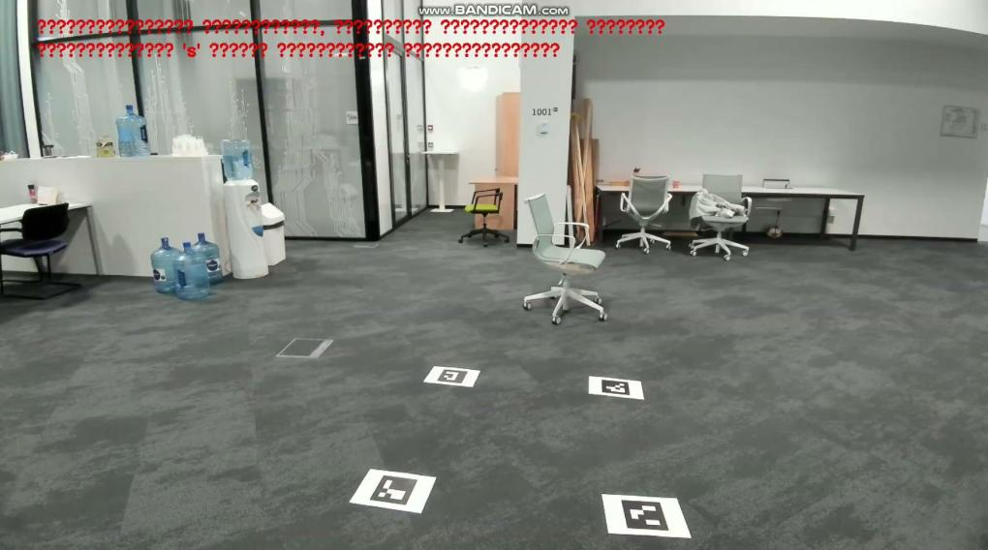
Implementation

Slide 18
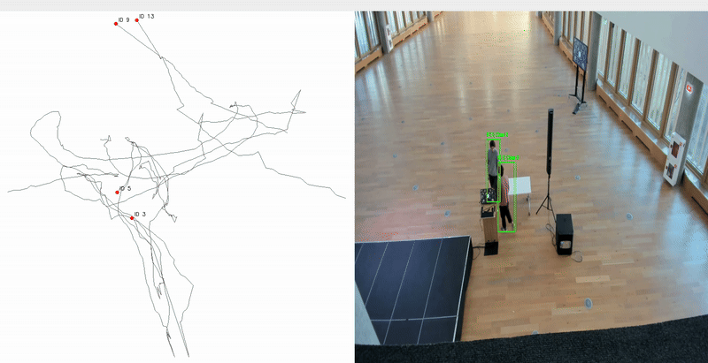
PREVIOUS approach
Data collection was done with a wide-angle RGB camera
Camera was set on an elevated area
Human tracking was performed with DeepSORT
Conclusion:
plane recognition was
not precise enough

Slide 19
Project plan
May 6-9: Data Collection
“Depth Anything” (RGB-only pipeline)
RGBD camera (manufacturer-calibrated)
May 10-12: Parallel Processing
Run trajectory extraction on both datasets
Compare foot position accuracy (+/- cm)
Note processing time differences
May 13-16: Quantitative Comparison
We should compare:
- Positional drift (per-frame differences)
- Impact parameter (b) consistency
- Processing time per 100 frames
May 13-16: Physics Validation
Check which method better predicts:
Acceleration vs distance relationship
Collision avoidance thresholds
May 21-27: Defense Prep
Superior method's results (highlight accuracy)
Side-by-side comparison graphs

Slide 20
Conclusions
Software Framework
custom & open–source solutions*
Hardware Framework
RGBD camera
+
*We suggest that you can use our setup and follow the steps from our repo.
Main insights
Experiment should be conducted with a larger testing group
More in-depth research should be made in case of complex (difficult-to-predict) trajectories
Some other hardware can be tested for this kind of task as well

Slide 21
References. SOTA on Social Force
(Chirality & Lane Formation) [1] focused on lane formation but assumed fixed pedestrian behavior without real-time adaptability.
(Visibility & Crowd Dynamics) [2] studied how visibility affects movement but didn’t include real-time adjustments to environmental changes.
(Collision Avoidance in Counterflow) [3] introduced an improved avoidance force but didn’t account for changing pedestrian densities in real time.
[1] Bodrova, A. S., Najim, F. A., & Brilliantov, N. V. (2022). Lane formation in an active particle model with chirality for pedestrian traffic. doi:10.48550/ARXIV.2209.05454
[2] Guo, N., Hao, Q.-Y., Jiang, R., Hu, M.-B., & Jia, B. (2016). Uni- and bi-directional pedestrian flow in the view-limited condition: Experiments and modeling. Transportation Research. Part C, Emerging Technologies, 71, 63–85. doi:10.1016/j.trc.2016.07.001
[3] Yang, J., Zang, X., Chen, W., Luo, Q., Wang, R., & Liu, Y. (2024). Improved social force model based on pedestrian collision avoidance behavior in counterflow. Physica A, 642(129762), 129762. doi:10.1016/j.physa.2024.129762

Slide 22
SOCIAL FORCE.
A new approach for improving the data quality

